Slide 1
PHP Strings

Slide 2
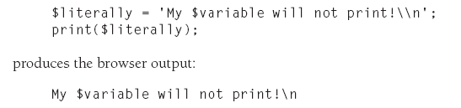
String Variables in PHP
Strings in PHP can be enclosed in either in single (or) double quotes with different behaviors.
$string=”Hello world”; (or) $ string = ‘Hello world’;
Both representations are same. Strings with empty quotes is called empty string
$string= “ “; (or) $string= ‘ ‘;
Difference between double quotes and single quotes for strings
Except for a couple of specially interpreted character sequences, singly quoted strings read in and store their characters literally. The following code:
$variable=”string”;

Slide 3
While using double quotes- Variable names (start with $) are replaced with string representations of their values.
$literally = “My $variable will not print!\\n”;
print($literally);
Produces the browser output:
My string will not print!\n
The Concatenation Operator
There is only one string operator in PHP. The concatenation operator (.) is used to put two string values together. To concatenate two string variables together, use the concatenation operator:
<?php
$txt1="Hello World!"; $txt2="What a nice day!"; echo $txt1 . " " . $txt2;
?>
The output of the code above will be:
Hello World! What a nice day!

Slide 4
String Manipulation and Regular Expression
ucwords - The ucwords() function converts the first character of each word in a string touppercase
Syntax: ucwords(string);
Example
<?php
echo ucwords("hello world");
?>
The output of the code above will be: Hello World
strtoupper - The strtoupper() function converts a string to uppercase.
Syntax: strtoupper(string);
Example
<?php
echo strtoupper("Hello WORLD!");
?>
The output of the code above will be: HELLO WORLD!

Slide 5
3. strtolower - The strtolower () function converts a string to lowercase.
Syntax: strtolower(string);
Example
<?php
echo strtolower("Hello WORLD.");
?>
The output of the code above will be: hello world.
str_replace - The str_replace() function replaces some characters with some other characters in a string.
<?php
echo str_replace("world","Peter","Hello world!");
?>
The output of the code above will be: Hello Peter!
. strpos - The strpos() function returns the position of the first occurrence of a string inside another string. If the string is not found, this function returns FALSE.
syntax: strpos(string,find,start);
<?php
echo strpos("Hello world!","wo");
?>
The output of the code above will be: 6

Slide 6
substr - The substr() function returns a part of a string.
Syntax : substr(string,start,length)
<?php
echo substr("Hello world!",6);
?>
The output of the code above will be: world!
stricmp - The strcmp() function compares two strings.This function returns:
• 0 - if the two strings are equal
• <0 - if string1 is less than string2
• >0 - if string1 is greater than string2
<?php
echo strcmp("Hello world!","Hello world!");
?>
The output of the code above will be: 0
strrev - The strrev() function reverses a string.
Syntax : strrev(string);
<?php
echo strrev("Hello World!");
?>
The output of the code above will be: !dlroW olleH

Slide 7
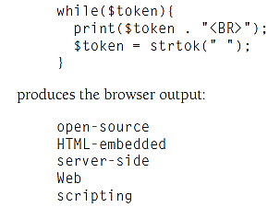
Strtok() : The process of breaking up a long string into words is called tokenizing
The strtok() function takes two arguments: the string to be broken up into tokens and a string containing all the delimiters (characters that count as boundaries between tokens).
On the first call, both arguments are used, and the string value returned is the first token. To retrieve subsequent tokens, make the same call, but omit the source string argument. For example:
$token = strtok(“open-source HTML-embedded server-side Web scripting”,“ “);

Slide 8
The explode() function: It takes two arguments: a separator string and the string to be separated. It returns an array where each element is a substring between instances of the separator in the string to be separated. For example:
$explode_result = explode(“AND”, “one AND a two AND a three”);
results in the array $explode_result having three elements, each of which is a string: “one “, “ a two “, and “ a three”.

Slide 9
THANK YOU

